Slide 1

Music Player
C++ Object-Oriented Programming Project

Slide 2
Introduction :
A Music Player Application is a digital tool for managing and enjoying music collections. It allows users to create playlists, add songs, rate tracks, and remove them, offering a basic music player experience. Built using Object-Oriented Programming (OOP) principles, it includes key classes like Song, Premium-Song, Playlist, and Music-Player.
Song: Represents a single track with attributes such as title, artist, duration, and rating.
Premium-Song: Extends Song with additional features.
Playlist: A collection of songs, supporting addition, removal, and display.
Music-Player: The interface for users to manipulate playlists, play songs, and manage ratings.
The application leverages OOP features like:
Inheritance: Premium-Song inherits properties of Song.
Polymorphism: Different song types are treated uniformly.
Encapsulation: Protects song details with controlled access.

Slide 3

Objectives :
Inheritance:
Inheritance allows us to create a class hierarchy where a derived class can inherit the attributes and methods of a base class . For a Music Player, the base class can be Music-Player, and derived classes can be Audio-Player and Video-Player.
Encapsulation:
Encapsulation involves bundling data and methods that operate on the data into a single class while restricting access to some of the class’s components using private or protected access specifiers.
Polymorphism:
Polymorphism allows methods to perform different tasks depending on the context, often achieved using function overriding or virtual functions in C++.

Slide 4
Key Features :
1.Basic Playback Controls:
Play/Pause: Start or pause a track.
Stop: Stop the currently playing track.
Next/Previous: Skip to the next or previous track in the playlist.
2. Playlist Management:
Create, edit, and delete playlists.
Shuffle and repeat playback options.
Sorting by artist, album, genre, or other criteria.
3. Media Library:
Store and organize songs by metadata such as title, artist, album, genre, and duration.
Search functionality to quickly find tracks.
4. Smart Features:
Recommendations based on listening habits.
Lyrics display in real-time.
Voice commands for hands-free control.
5. Streaming and Downloads:
Integration with online music streaming platforms.
Ability to download tracks for offline listening.
6. Energy Efficiency:
Low power consumption during playback, especially on mobile devices
7.Advanced Playback Features:
Crossfade between tracks.
Gapless playback for uninterrupted listening.
Playback speed control for podcasts or audiobooks.

Slide 5
Implementation :
#include <iostream>
#include <vector>
#include <string>
#include <algorithm>
using namespace std;
class Song {
private:
string title;
string artist;
double duration;
int rating;
public:
Song(string t, string a, double d) : title(t), artist(a), duration(d), rating(0) {}
string getTitle() const { return title; }
string getArtist() const { return artist; }
double getDuration() const { return duration; }
int getRating() const { return rating; }

Slide 6
void setRating(int r) {
if (r >= 0 && r <= 5) rating = r;
else cout << "Invalid rating! Please provide a value between 0 and 5.\n";
}
virtual void displayDetails() const {
cout << "Title: " << title << ", Artist: " << artist << ", Duration: " << duration << " mins, Rating: " << rating << "/5\n";
}
};
class PremiumSong : public Song {
private:
string feature;
public:
PremiumSong(string t, string a, double d, string f) : Song(t, a, d), feature(f) {}

Slide 7
void displayDetails() const override {
Song::displayDetails();
cout << "Additional Feature: " << feature << "\n";
}
};
class Subscription {
private:
bool isSubscribed;
public:
Subscription() : isSubscribed(false) {}
void subscribe() {
isSubscribed = true;

Slide 8
cout << "Subscription activated! Enjoy premium features.\n";
}
void cancelSubscription() {
isSubscribed = false;
cout << "Subscription cancelled. You can only access regular songs.\n";
}
bool isUserSubscribed() const {
return isSubscribed;
}
};
class Playlist {
private:
string name;
vector<Song *> songs;
public:
Playlist(string n) : name(n) {}
void addSong(Song *song) {
songs.push_back(song);

Slide 9
cout << "Song \"" << song->getTitle() << "\" added to playlist \"" << name << "\".\n";
}
void removeSong(const string &title) {
auto it = remove_if(songs.begin(), songs.end(), [&title](Song *s) {
return s->getTitle() == title;
});
if (it != songs.end()) {
cout << "Song \"" << (*it)->getTitle() << "\" removed from playlist \"" << name << "\".\n";
songs.erase(it, songs.end());
} else {
cout << "Song \"" << title << "\" not found in playlist.\n";
}
}
Song *searchSong(const string &query) const {
for (auto *song : songs) {
if (song->getTitle() == query || song->getArtist() == query) return song;
}
return nullptr;
}

Slide 10
void displaySongs() const {
cout << "\nPlaylist: " << name << "\n";
if (songs.empty()) {
cout << "No songs in the playlist.\n";
return;
}
for (auto *song : songs) song->displayDetails();
}
const vector<Song *> &getSongs() const { return songs; }
string getName() const { return name; }
};
class MusicPlayer {
private:
Playlist *currentPlaylist;
Subscription subscription;
public:
MusicPlayer() : currentPlaylist(nullptr) {}
void setPlaylist(Playlist *playlist) {
currentPlaylist = playlist;

Slide 11
cout << "Playlist \"" << playlist->getName() << "\" is now active.\n";
}
void playAll() const {
if (!currentPlaylist) {
cout << "No playlist set.\n";
return;
}
cout << "Playing all songs in playlist \"" << currentPlaylist->getName() << "\":\n";
for (auto *song : currentPlaylist->getSongs()) {
cout << "Playing: " << song->getTitle() << " by " << song->getArtist() << "\n";
}
}
void addSongToPlaylist(Playlist &playlist) {
string title, artist, type;
double duration;
cout << "Enter song title: ";
cin.ignore();
getline(cin, title);
cout << "Enter artist name: ";
getline(cin, artist);
cout << "Enter duration (in minutes): ";

Slide 12
cin >> duration;
cout << "Enter song type ('regular' or 'premium'): ";
cin >> type;
if (type == "premium" && subscription.isUserSubscribed()) {
string feature;
cout << "Enter additional feature: ";
cin.ignore();
getline(cin, feature);
playlist.addSong(new PremiumSong(title, artist, duration, feature));
} else if (type == "regular") {
playlist.addSong(new Song(title, artist, duration));
} else {
cout << "You need a subscription to add premium songs.\n";
}
}
void searchAndRateSong(Playlist &playlist) {
string title;
cout << "Enter song title to search and rate: ";
cin.ignore();
getline(cin, title);
Song *song = playlist.searchSong(title);

Slide 13
if (song) {
song->displayDetails();
int rating;
cout << "Enter rating (0 to 5): ";
cin >> rating;
song->setRating(rating);
} else {
cout << "Song \"" << title << "\" not found in playlist.\n";
}
}
void subscribe() {
subscription.subscribe();
}
void cancelSubscription() {
subscription.cancelSubscription();
}
};
int main() {
MusicPlayer player;
Playlist myPlaylist("My Playlist");
int choice;

Slide 14
do {
cout << "\n*** Music Player Menu ***\n";
cout << "1. Add Song to Playlist\n";
cout << "2. Display All Songs in Playlist\n";
cout << "3. Play All Songs\n";
cout << "4. Search and Rate a Song\n";
cout << "5. Remove a Song from Playlist\n";
cout << "6. Subscribe\n";
cout << "7. Cancel Subscription\n";
cout << "8. Exit\n";
cout << "Enter your choice: ";
cin >> choice;
switch (choice) {
case 1:
player.addSongToPlaylist(myPlaylist);
break;
case 2:
myPlaylist.displaySongs();
break;
case 3:
player.setPlaylist(&myPlaylist);
player.playAll();
break;

Slide 15
case 4:
player.searchAndRateSong(myPlaylist);
break;
case 5: {
string title;
cout << "Enter the title of the song to remove: ";
cin.ignore();
getline(cin, title);
myPlaylist.removeSong(title);
break;
}
case 6:
player.subscribe();
break;
case 7:
player.cancelSubscription();
break;
case 8:
cout << "Exiting Music Player. Goodbye!\n";
break;
default:
cout << "Invalid choice! Please try again.\n";
}
} while (choice != 8);
return 0;
}

Slide 16
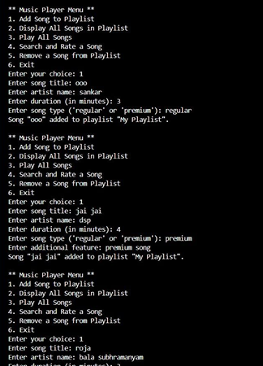
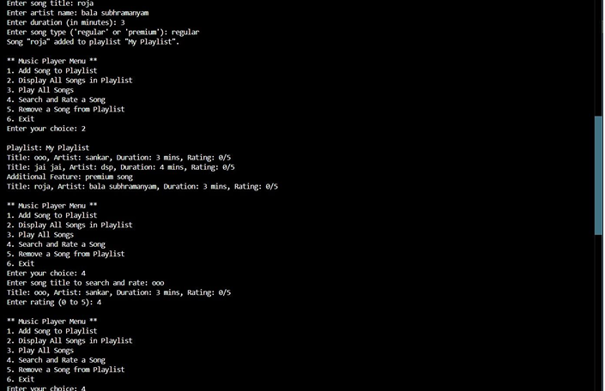

Output :

Slide 17
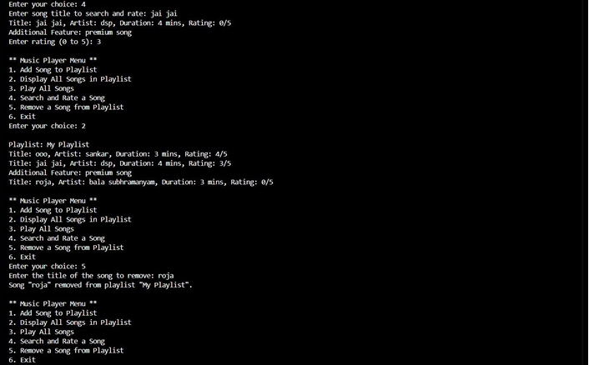
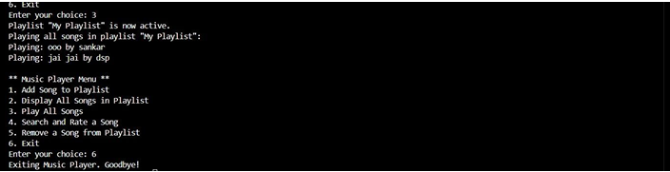
Output :

Slide 18
Conclusion :
Strengths
Clear implementation of OOP concepts.
Straightforward user interface with essential playlist features .
Areas for Improvement
1. Memory Management:
The use of raw pointers for storing songs can lead to memory leaks. Switching to smart pointers like std::unique_ptr or std::shared_ptr would enhance safety.
The provided code effectively demonstrates key object-oriented principles like inheritance, polymorphism, and encapsulation. The Song class serves as the foundation, while Premium-Song extends it by adding new features and overriding methods, showcasing inheritance and method overriding. The Playlist class manages a collection of songs, and the Music-Player class provides user-friendly interactions, allowing operations like adding, removing, rating, and playing songs .
2. Input Validation:
Ensure valid song details (e.g., non-empty title, realistic duration) to improve robustness.
Potential Enhancements
Add shuffle playback for a dynamic listening experience.
Implement file handling to save/load playlists.
Include additional metadata like album or genre for better organization.

